Slide 1
Unit – II
Working with Basic Building Blocks of PHP

Slide 2
PHP Introduction
PHP is a recursive acronym for “PHP: Hypertext Preprocessor” -- It is a widely-used open source general-purpose scripting language that is especially suited for web development and can be embedded into HTML.

Slide 3
PHP Introduction
PHP is a server-side scripting language
PHP scripts are executed on the server
PHP supports many databases (MySQL, Informix, Oracle, Sybase, Solid, PostgreSQL, Generic ODBC, etc.)‏
PHP is open source software
PHP is free to download and use

Slide 4
PHP Introduction
PHP runs on different platforms (Windows, Linux, Unix, etc.)‏
PHP is compatible with almost all servers used today (Apache, IIS, etc.)‏
PHP is FREE to download from the official PHP resource: www.php.net
PHP is easy to learn and runs efficiently on the server side.

Slide 5
PHP Introduction
Some info on MySQL which we will cover in the next workshop.
MySQL is a database server
MySQL is ideal for both small and large applications
MySQL supports standard SQL
MySQL compiles on a number of platforms
MySQL is free to download and use

Slide 6
PHP Introduction
Instead of lots of commands to output HTML (as seen in C or Perl), PHP pages contain HTML with embedded code that does "something" (like in the next slide, it outputs "Hi, I'm a PHP script!").
The PHP code is enclosed in special start and end processing instructions <?php and ?> that allow you to jump into and out of "PHP mode."

Slide 7
PHP Start & END Tags
Standard PHP Tags
    <?php
    echo “Hello World”;
    ?>
Script Tags
  <script language = “php”>
  echo “Hello World”;
  </script>

Slide 8
PHP Start & END Tags
Short Tags
  <?
  echo “Hello World”;
  ?>
  Requires short_open_tag.ini in configuration file directive or if php is configured with the enable-short-tags option.
ASP Style Tags
<%
echo “Hello World”;
%>

Slide 9
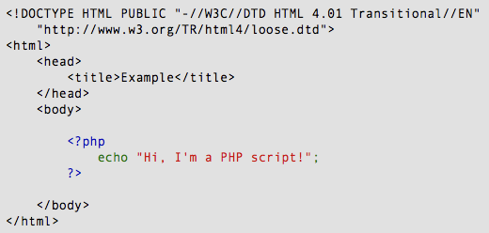
PHP Introduction

Slide 10
PHP Introduction
PHP code is executed on the server, generating HTML which is then sent to the client. The client would receive the results of running that script, but would not know what the underlying code was.
A visual, if you please...

Slide 11
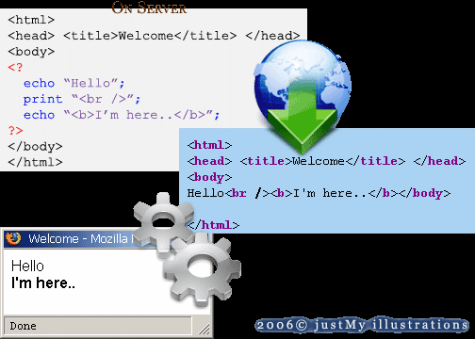
PHP Introduction

Slide 12
Brief History of PHP
PHP (PHP: Hypertext Preprocessor) was created by Rasmus Lerdorf in 1994. It was initially developed for HTTP usage logging and server-side form generation in Unix.
PHP 2 (1995) transformed the language into a Server-side embedded scripting language. Added database support, file uploads, variables, arrays, recursive functions, conditionals, iteration, regular expressions, etc.
PHP 3 (1998) added support for ODBC data sources, multiple platform support, email protocols (SNMP,IMAP), and new parser written by Zeev Suraski and Andi Gutmans .

Slide 13
Brief History of PHP
PHP 4 (2000) became an independent component of the web server for added efficiency. The parser was renamed the Zend Engine. Many security features were added.
PHP 5 (2004) adds Zend Engine II with object oriented programming, robust XML support using the libxml2 library, SOAP extension for interoperability with Web Services, SQLite has been bundled with PHP

Slide 14
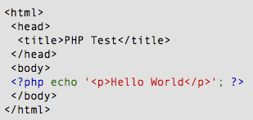
PHP Hello World
Above is the PHP source code.

Slide 15
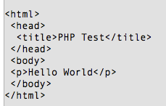
PHP Hello World
It renders as HTML that looks like this:

Slide 16
PHP Hello World
This program is extremely simple and you really did not need to use PHP to create a page like this. All it does is display: Hello World using the PHP echo() statement.
Think of this as a normal HTML file which happens to have a set of special tags available to you that do a lot of interesting things.

Slide 17
Displaying Data
There are two language constructs available to display data: print() and echo().
They can be used with or without brackets.
Note that the data ‘displayed’ by PHP is actually parsed by your browser as HTML. View source to see actual output.

Slide 18
Displaying data
<?php
echo ‘Hello World!<br />’;
echo(‘Hello World!<br />’);
print ‘Hello World!<br />’;
print(‘Hello World!<br />’);
?>

Slide 19
Escaping Characters
Some characters are considered ‘special’
Escape these with a backslash \
Special characters will be flagged when they arise, for example a double or single quote belong in this group…

Slide 20
Escaping Characters
<?php
// Claire O’Reilly said “Hello”.
echo ‘Claire O\’Reilly ’;
echo “said \”Hello\”.”;
?>

Slide 21
PHP Data Types
Variables can store data of different types, and different data types can do different things.
PHP supports the following data types:
      String
      Integer
      Float (floating point numbers - also called double)
      Boolean
      Array
      Object
      NULL
      Resource

Slide 22
PHP String
A string is a sequence of characters, like "Hello world!".
A string can be any text inside quotes. You can use single or double quotes:
Example
          <?php
          $x = "Hello world!";
          $y = 'Hello world!';
          echo $x;
          echo "<br>";
          echo $y;
          ?>

Slide 23
PHP Integer
An integer data type is a non-decimal number between -2,147,483,648 and 2,147,483,647.
Rules for integers:
      An integer must have at least one digit
      An integer must not have a decimal point
      An integer can be either positive or negative
      Integers can be specified in three formats: decimal (10-based), hexadecimal (16-based - prefixed with 0x) or octal (8-based - prefixed with 0)
      In the following example $x is an integer. The PHP var_dump() function returns the data type and value:
Example
          <?php
            $x = 5985;
            var_dump($x);
          ?>

Slide 24
PHP Float
A float (floating point number) is a number with a decimal point or a number in exponential form.
In the following example $x is a float. The PHP var_dump() function returns the data type and value:
Example
            <?php
            $x = 10.365;
            var_dump($x);
            ?>

Slide 25
PHP Boolean
A Boolean represents two possible states: TRUE or FALSE.
$x = true;
$y = false;
Booleans are often used in conditional testing. You will learn more about conditional testing in a later chapter of this tutorial.

Slide 26
PHP Array
An array stores multiple values in one single variable.
In the following example $cars is an array. The PHP var_dump() function returns the data type and value:
        Example
        <?php
        $cars = array("Volvo","BMW","Toyota");
        var_dump($cars);
        ?>

Slide 27
PHP Object
An object is a data type which stores data and information on how to process that data.
In PHP, an object must be explicitly declared.
First we must declare a class of object. For this, we use the class keyword. A class is a structure that can contain properties and methods:
Example
<?php
          class Car {
          function Car() {
          $this->model = "VW"; } }
          // create an object
          $herbie = new Car();
          // show object properties
          echo $herbie->model;
          ?>

Slide 28
PHP NULL Value
Null is a special data type which can have only one value: NULL.
A variable of data type NULL is a variable that has no value assigned to it.
Tip: If a variable is created without a value, it is automatically assigned a value of NULL.
Variables can also be emptied by setting the value to NULL:
  Example
          <?php
          $x = "Hello world!";
          $x = null;
          var_dump($x);
          ?>

Slide 29
PHP Resource
The special resource type is not an actual data type. It is the storing of a reference to functions and resources external to PHP.
A common example of using the resource data type is a database call.
We will not talk about the resource type here, since it is an advanced topic.

Slide 30
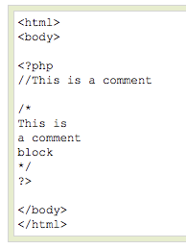
PHP Comments
In PHP, we use // or # to make a single-line comment or /* and */ to make a large comment block.
Do not nest multi-line comments
// recommended over #

Slide 31
Comments
<?php
// this is a comment
echo ‘Hello World!’;
/* another
multi-line comment */
?>

Slide 32
Constants
Constants (unchangeable variables) can also be defined.
Each constant is given a name (note no preceding dollar is applied here).
By convention, constant names are usually in UPPERCASE.
Notes:
A constant is an identifier for a single value…
Cannot be changed during execution (or undefined)
Same naming convention as a standard variable (just no $)
Are global (can be accessed anywhere – within functions, etc.)
There are many predefined constants (see www.php.net for the long list!)
Core constants
Set in the PHP core…
Mostly to do with error tracking and also core items like version, install directories, etc.
Standard constants
Loads more!
Extension constants
These are set by extensions if they are loaded
See individual extension descriptions for details

Slide 33
Constants
<?php
define(‘NAME’,‘Phil’);
define(‘AGE’,23);
echo NAME;
echo ’ is ‘;
echo AGE;
// Phil is 23
?>

Slide 34
Predefined Constants
These constants are defined by the PHP core. This includes PHP, the Zend engine, and SAPI modules.
PHP_VERSION (string) :The current PHP version as a string in "major.minor.release[extra]" notation.
PHP_MAJOR_VERSION (integer) : The current PHP "major" version as an integer (e.g., int(5) from version "5.2.7-extra"). Available since PHP 5.2.7.
PHP_MINOR_VERSION (integer) : The current PHP "minor" version as an integer (e.g., int(2) from version "5.2.7-extra"). Available since PHP 5.2.7.
PHP_RELEASE_VERSION (integer) : The current PHP "release" version as an integer (e.g., int(7) from version "5.2.7-extra"). Available since PHP 5.2.7.
PHP_VERSION_ID (integer) : The current PHP version as an integer, useful for version comparisons (e.g., int(50207) from version "5.2.7-extra"). Available since PHP 5.2.7.

Slide 35
Magic Constants
PHP provides a large number of predefined constants to any script which it runs.
There are five magical constants that change depending on where they are used. For example, the value of __LINE__ depends on the line that it's used on in your script. These special constants are case-insensitive and are as follows −

Slide 36
Magic Constants
Sr. No | Name | Description
1 | __LINE__ | The current line number of the file.
2 | __FILE__ | The full path and filename of the file. If used inside an include, the name of the included file is returned. Since PHP 4.0.2, __FILE__ always contains an absolute path whereas in older versions it contained relative path under some circumstances.
3 | __FUNCTION__ | The function name. (Added in PHP 4.3.0) As of PHP 5 this constant returns the function name as it was declared (case-sensitive). In PHP 4 its value is always lowercased.
4 | __CLASS__ | The class name. (Added in PHP 4.3.0) As of PHP 5 this constant returns the class name as it was declared (case-sensitive). In PHP 4 its value is always lowercased.
5 | __METHOD__ | The class method name. (Added in PHP 5.0.0) The method name is returned as it was declared (case-sensitive).

Slide 37
PHP is a Loosely Typed Language
PHP automatically converts the variable to the correct data type, depending on its value.
In other languages such as C, C++, and Java, the programmer must declare the name and type of the variable before using it.
But in PHP we need not to tell datatype while declaring the variable and we can change the variable value as well like can store integer value in string as well.

Slide 38
Scope of Variable
Scope can be defined as the range of availability a variable has to the program in which it is declared. PHP variables can be one of four scope types as below
Local variables : A variable declared in a function is considered local; that is, it can be referenced solely in that function. Any assignment outside of that function will be considered to be an entirely different variable from the one contained in the function.
Function parameters : Function parameters are declared after the function name and inside parentheses. They are declared much like a typical variable would be called in function.

Slide 39
Scope of Variable
Global variables :global variable can be accessed in any part of the program. However, in order to be modified, a global variable must be explicitly declared to be global in the function in which it is to be modified. This is accomplished, conveniently enough, by placing the keyword GLOBAL in front of the variable that should be recognized as global. Placing this keyword in front of an already existing variable tells PHP to use the variable having that name.
Static variables : The final type of variable scoping that I discuss is known as static. In contrast to the variables declared as function parameters, which are destroyed on the function's exit, a static variable will not lose its value when the function exits and will still hold that value should the function be called again. You can declare a variable to be static simply by placing the keyword STATIC in front of the variable name.

Slide 40

PHP Variables
Variables are used for storing values, like text strings, numbers or arrays.
When a variable is declared, it can be used over and over again in your script.
All variables in PHP start with a $ sign symbol.
The correct way of declaring a variable in PHP:

Slide 41

PHP Variables
In PHP, a variable does not need to be declared before adding a value to it.
In the example above, you see that you do not have to tell PHP which data type the variable is.
PHP automatically converts the variable to the correct data type, depending on its value.

Slide 42
PHP Variables
A variable name must start with a letter or an underscore "_" -- not a number
A variable name can only contain alpha-numeric characters, underscores (a-z, A-Z, 0-9, and _ )‏
A variable name should not contain spaces. If a variable name is more than one word, it should be separated with an underscore ($my_string) or with capitalization ($myString)‏

Slide 43
Variables: example
<?php
$name = ‘Phil’;
$age = 23;
echo $name;
echo ’ is ‘;
echo $age;
// Phil is 23
?>
Notes:
Demo the fact that the variable can be changed..
$name = ‘Phil’;
$age = 23;
$name = ‘Ed’;
echo $name;
echo ’ is ‘;
echo $age;
// Ed is 23

Slide 44
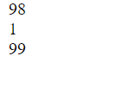
settype() function
The settype() function is used to set the type of a variable.
Syntax
bool settype(var_name, var_type)
var_name : The variable being converted and mandatory.
var_type : Type of the variable. Possible values are : boolean, integer, float, string, array, object, null.
This functions Boolean value true or false.
        <?php
        $var1='98';
        $var2='01';
        settype($var1, "integer");
        settype($var2, "integer");
        echo ($var1.'<br>');
        echo ($var2.'<br>');
        echo ($var1+$var2.'<br>');
        ?>

Slide 45
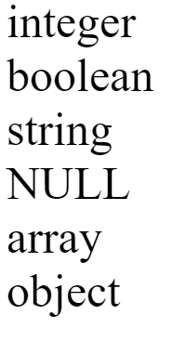
gettype()
The gettype() function is used to get the type of a variable.
Syntax
datatypes gettype(var_name)
var_name : The name of variable and mandatory.
<?php
echo gettype(102).'<br>';
echo gettype(true).'<br>';
echo gettype(' ').'<br>';
echo gettype(null).'<br>';
echo gettype(array()).'<br>';
echo gettype(new stdclass());
?>

Slide 46
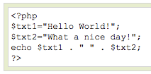
PHP Concatenation
The concatenation operator (.) is used to put two string values together.
To concatenate two string variables together, use the concatenation operator:

Slide 47

PHP Concatenation
The output of the code on the last slide will be:
If we look at the code you see that we used the concatenation operator two times. This is because we had to insert a third string (a space character), to separate the two strings.

Slide 48
PHP Operators
Operators are used to operate on values. There are four classifications of operators:
  Arithmetic
  Assignment
  Comparison
  Logical
  ? Ternary

Slide 49
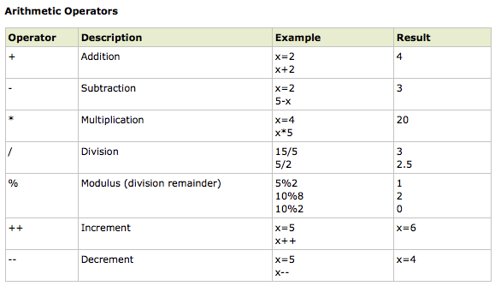
PHP Operators

Slide 50
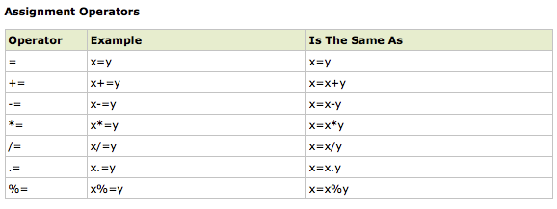
PHP Operators

Slide 51
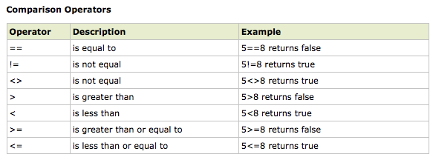
PHP Operators

Slide 52
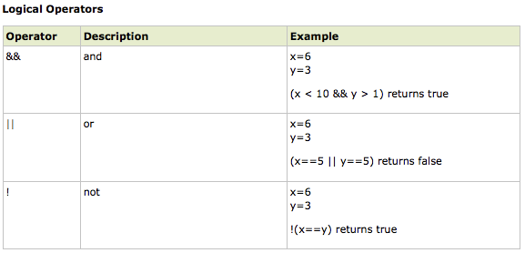
PHP Operators

Slide 53
? Ternary Operator
Ternary operator logic is the process of using "(condition) ? (true return value) : (false return value)" statements to shorten your if/else structures.
$var = 5;
$greater_than_two = ($var > 2 ? true : false); // returns true

Slide 54
Advantages of ? Operator
Makes coding simple if/else logic quicker
You can do your if/else logic inline with output instead of breaking your output building for if/else statements
Makes code shorter
Makes maintaining code quicker, easier

Slide 55
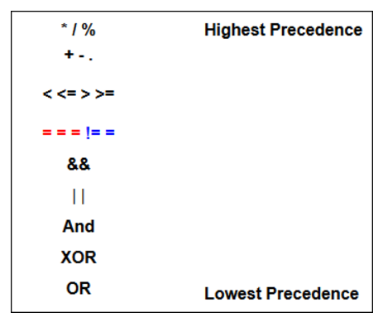
Operator Precedence

Slide 56
PHP Conditional Statements
Very often when you write code, you want to perform different actions for different decisions.
You can use conditional statements in your code to do this.
In PHP we have the following conditional statements...

Slide 57
PHP Conditional Statements
if statement - use this statement to execute some code only if a specified condition is true
if...else statement - use this statement to execute some code if a condition is true and another code if the condition is false
if...elseif....else statement - use this statement to select one of several blocks of code to be executed
switch statement - use this statement to select one of many blocks of code to be executed

Slide 58
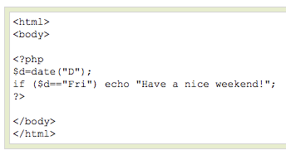
PHP Conditional Statements
The following example will output "Have a nice weekend!" if the current day is Friday:

Slide 59
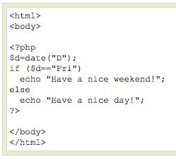
PHP Conditional Statements
Use the if....else statement to execute some code if a condition is true and another code if a condition is false.

Slide 60
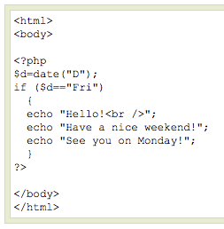
PHP Conditional Statements
If more than one line should be executed if a condition is true/false, the lines should be enclosed within curly braces { }

Slide 61
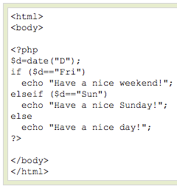
PHP Conditional Statements
The following example will output "Have a nice weekend!" if the current day is Friday, and "Have a nice Sunday!" if the current day is Sunday. Otherwise it will output "Have a nice day!":

Slide 62
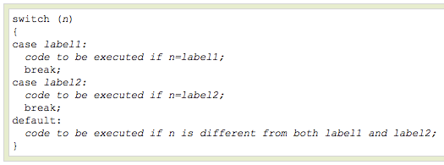
PHP Conditional Statements
Use the switch statement to select one of many blocks of code to be executed.

Slide 63
PHP Conditional Statements
For switches, first we have a single expression n (most often a variable), that is evaluated once.
The value of the expression is then compared with the values for each case in the structure. If there is a match, the block of code associated with that case is executed.
Use break to prevent the code from running into the next case automatically. The default statement is used if no match is found.

Slide 64
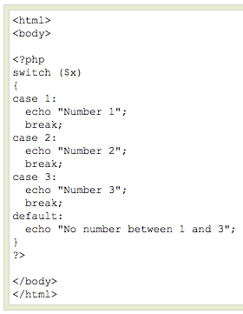
PHP Conditional Statements

Slide 65
PHP Loops
Often when you write code, you want the same block of code to run over and over again in a row. Instead of adding several almost equal lines in a script we can use loops to perform a task like this.
In PHP, we have the following looping statements:

Slide 66
PHP Loops
while - loops through a block of code while a specified condition is true
do...while - loops through a block of code once, and then repeats the loop as long as a specified condition is true
for - loops through a block of code a specified number of times
foreach - loops through a block of code for each element in an array

Slide 67
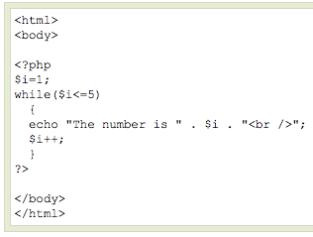
PHP Loops - While
The while loop executes a block of code while a condition is true. The example below defines a loop that starts with
i=1. The loop will
continue to run as
long as i is less
than, or equal to 5.
i will increase by 1
each time the loop
runs:

Slide 68
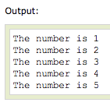
PHP Loops - While

Slide 69
PHP Loops – Do ... While
The do...while statement will always execute the block of code once, it will then check the condition, and repeat the loop while the condition is true.
The next example defines a loop that starts with i=1. It will then increment i with 1, and write some output. Then the condition is checked, and the loop will continue to run as long as i is less than, or equal to 5:

Slide 70
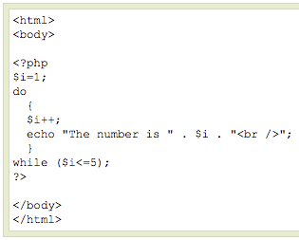
PHP Loops – Do ... While

Slide 71
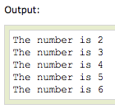
PHP Loops – Do ... While

Slide 72
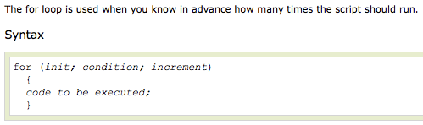
PHP Loops - For

Slide 73
PHP Loops - For
Parameters:
init: Mostly used to set a counter (but can be any code to be executed once at the beginning of the loop)‏
condition: Evaluated for each loop iteration. If it evaluates to TRUE, the loop continues. If it evaluates to FALSE, the loop ends.
increment: Mostly used to increment a counter (but can be any code to be executed at the end of the loop)‏

Slide 74
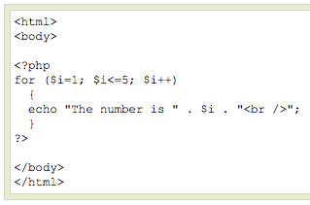
PHP Loops - For
The example below defines a loop that starts with i=1. The loop will continue to run as long as i is less than, or equal to 5. i will increase by 1 each time the loop runs:

Slide 75
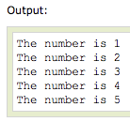
PHP Loops - For

Slide 76

PHP Loops - Foreach
For every loop iteration, the value of the current array element is assigned to $value (and the array pointer is moved by one) - so on the next loop iteration, you'll be looking at the next array value.

Slide 77
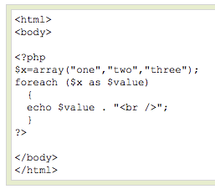
PHP Loops - Foreach
The following example demonstrates a loop that will print the values of the given array:

Slide 78

PHP Loops - Foreach
Winner of the most impressive slide award

Slide 79
continue Statement
Sometimes a situation arises where we want to take the control to the beginning of the loop (for example for, while, do while etc.) skipping the rest statements inside the loop which have not yet been executed.
The keyword continue allow us to do this. When the keyword continue executed inside a loop the control automatically passes to the beginning of loop. Continue is usually associated with the if.

Slide 80
Continue Statement Example
<?php
$x=1;
echo 'List of odd numbers between 1 to 10 <br />';
while ($x<=10)
{
if (($x % 2)==0)
{
$x++;
continue;
}
else
{
echo $x.'<br />';
$x++;
}
}
Output
List of odd numbers between 1 to 10
1
3
5
7
9

Slide 81
Break Statement
Sometimes a situation arises where we want to exit from a loop immediately without waiting to get back to the conditional statement.
The keyword break ends execution of the current for, foreach, while, do while or switch structure. When the keyword break executed inside a loop the control automatically passes to the first statement outside the loop. A break is usually associated with the if.

Slide 82
Break Statement Example.
<?php
$array1=array(100, 1100, 200, 400, 900);
$x1=0;
$sum=0
while ($x1<=4)
{
if ($sum>1500)
{
break;
}
$sum = $sum+$array1[$x1];
$x1=$x1+1;
}
echo $sum;
?>
Output :
1800

Slide 83
Thank You

